Slide 1
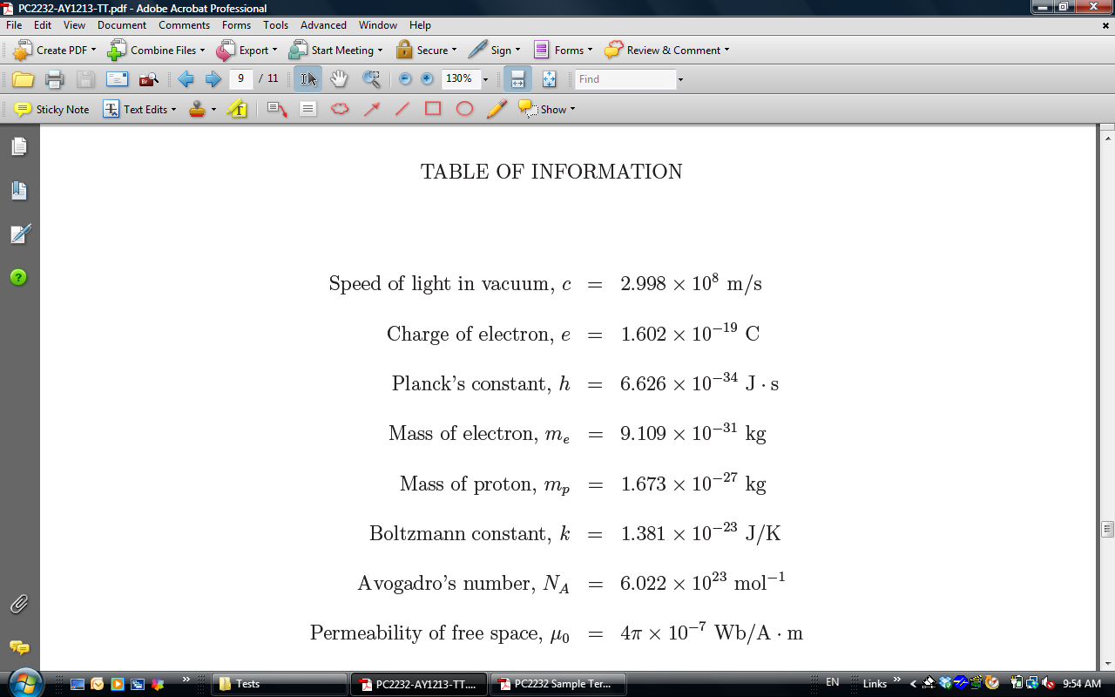
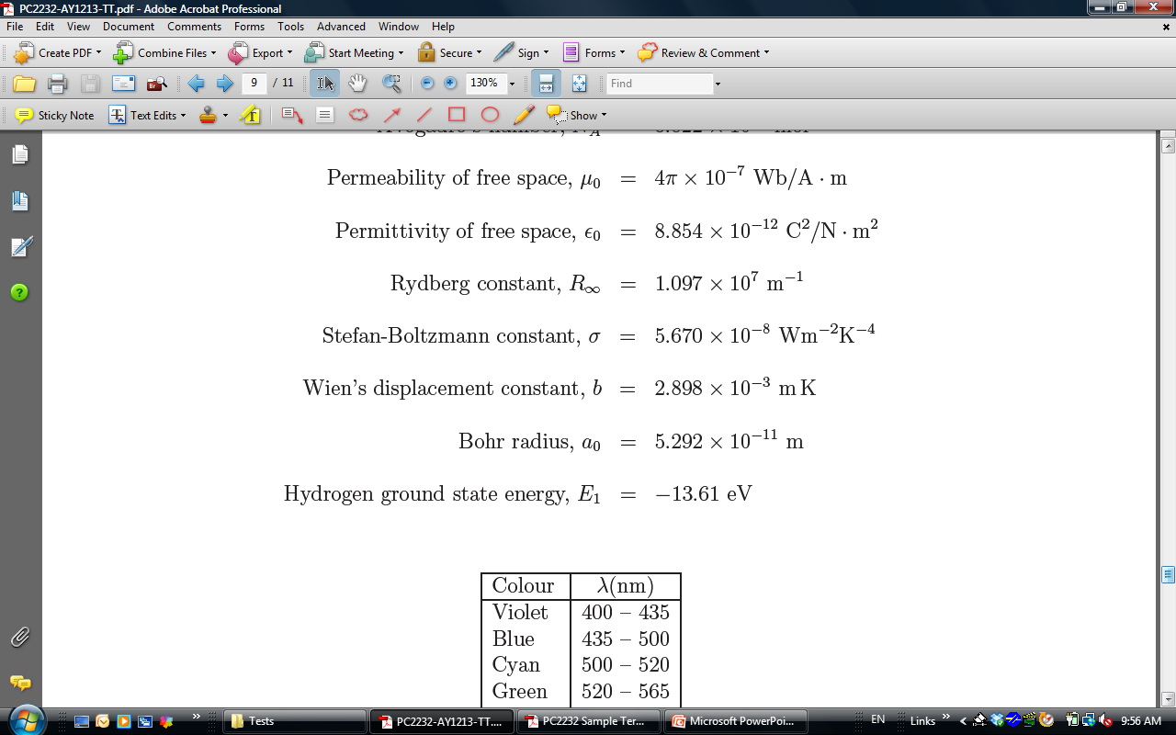

Slide 2
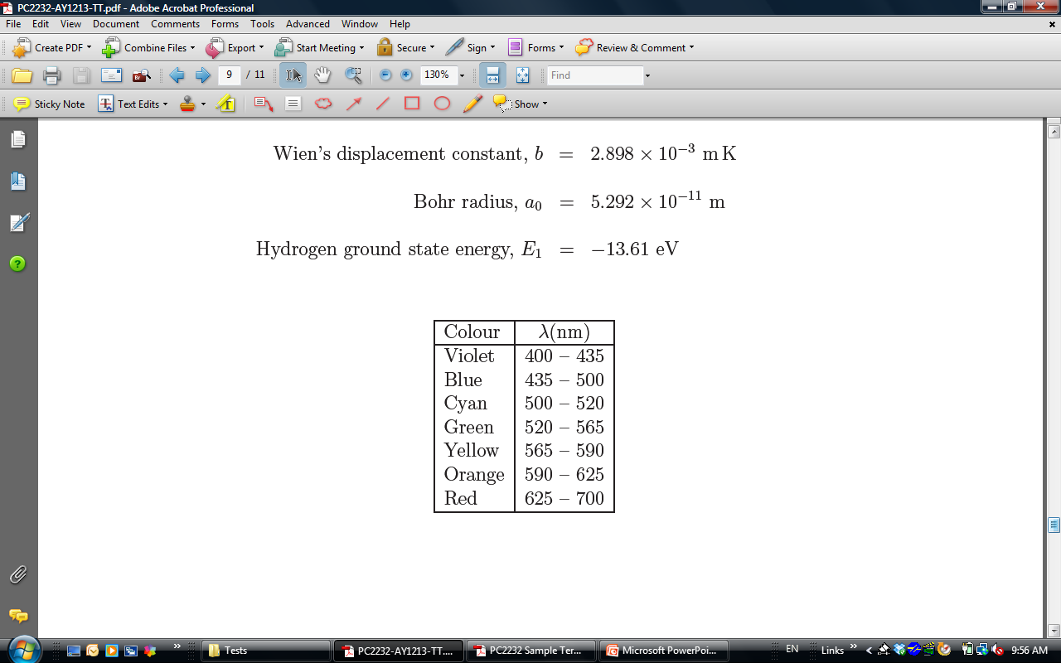

Slide 3
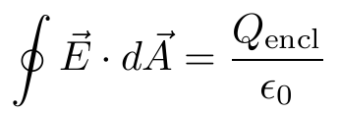
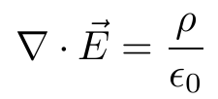
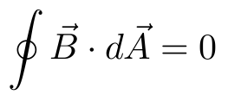

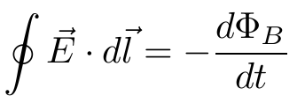
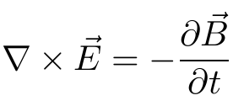
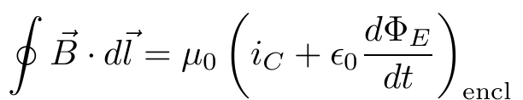
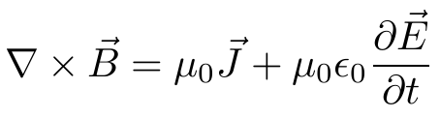
Maxwell Equations
 | Integral Form | Differential Form
Gauss’s Law
Gauss’s Law (magnetism)
Faraday’s Law
Ampere’s Law

Slide 4
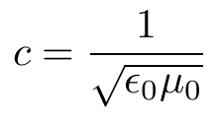
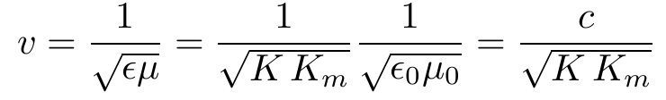

Speed of light in vacuum
Speed of light in Matter
index of refraction n of the material:

Slide 5
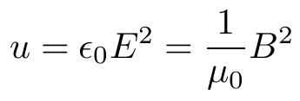
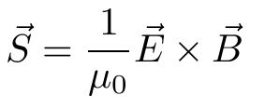
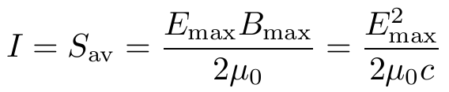
Energy Density of EM Wave
Poynting Vector
Intensity

Slide 6
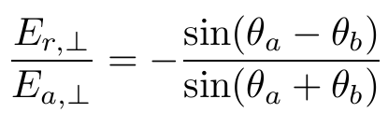
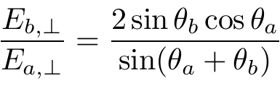
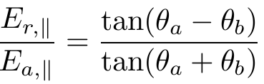
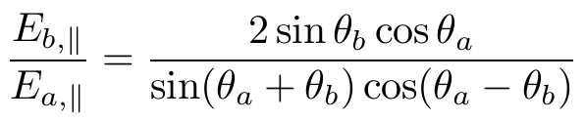

Fresnel’s Equations
for normal incidence

Slide 7


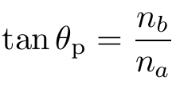
Malus’s Law
Law of Refraction
Brewster’s Law

Slide 8

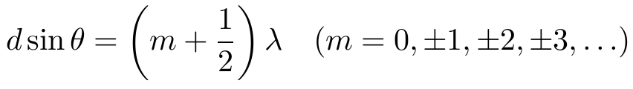

Double Slit Interference
Constructive interference
Destructive interference
Intensity in Interference Pattern

Slide 9
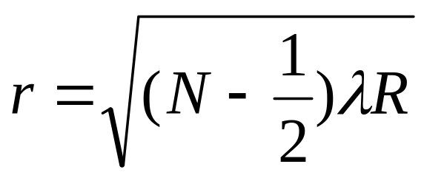
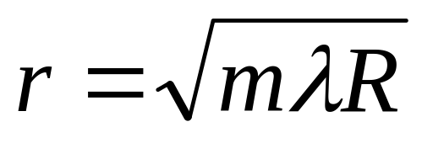
Newton’s Rings
Radius for Bright Ring
N^{th} bright ring (m=N-1)
Radius for Dark Ring

Slide 10
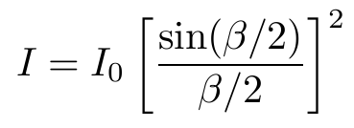
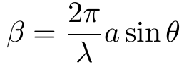
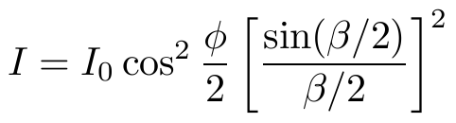
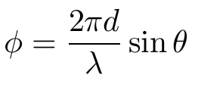
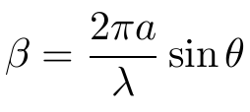
Intensity of Diffraction Pattern
Two slits of Finite Width

Slide 11


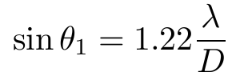

Diffraction Grating
constructive interference
X-ray Diffraction
Bragg condition
Circular Aperture
first dark ring
Rayleigh’s criterion

Slide 12


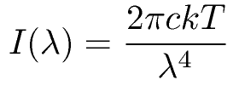
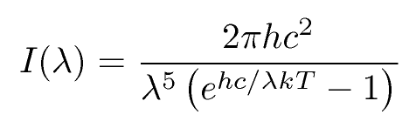
Stefan’s Law
Wien’s Law
Rayleigh-Jeans formula
Planck’s Radiation Law

Slide 13

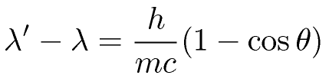
Photoelectric Effect
Work function of some common materials
Element | φ (eV)
Aluminum | 4.3
Carbon | 5.0
Copper | 4.7
Gold | 5.1
Nickel | 5.1
Silicon | 4.8
Silver | 4.3
Sodium | 2.3
Compton Formula

Slide 14
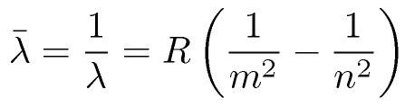
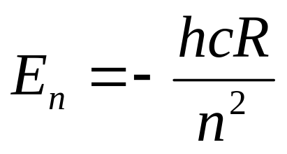
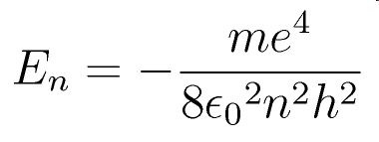
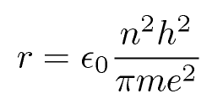
Rydberg Formula
Energy of Hydrogen Atom
Bohr Hydrogen Atom
Energy
Radius

Slide 15
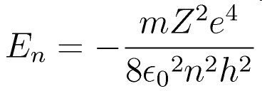
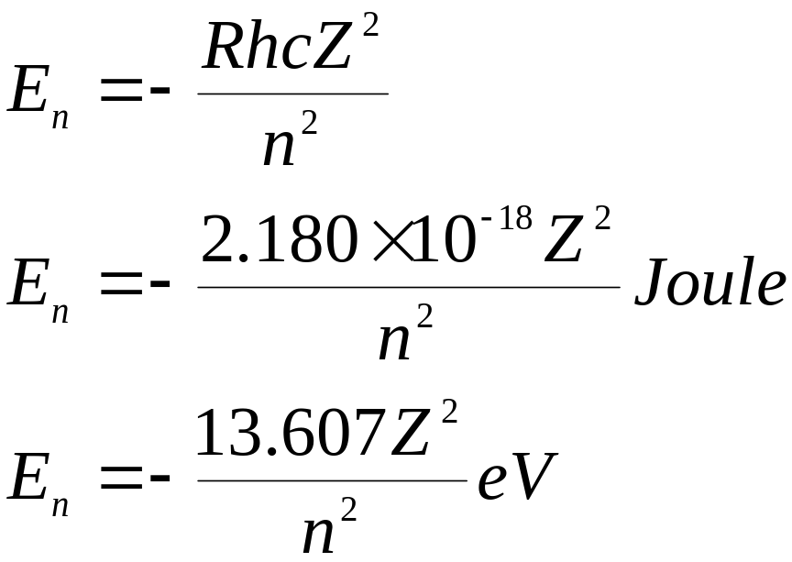
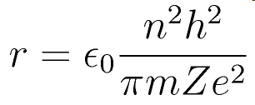
Bohr Hydrogen-like System
Energy
Radius

Slide 16
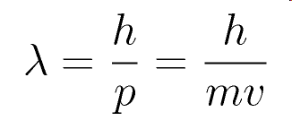



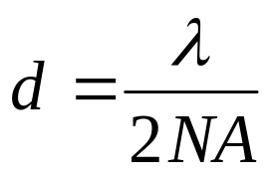
de Broglie’s Wavelength
Heisenberg Uncertainty Principles
where
Resolution of Optical Microscope

